Slide 1
Conference of European Churches

Slide 2
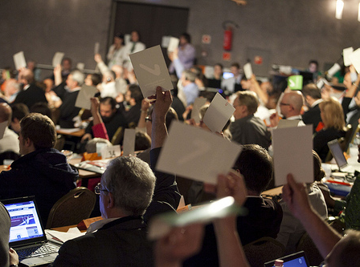
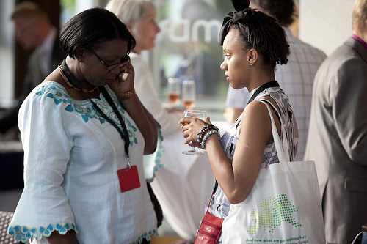
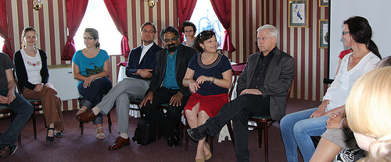
Content of
the Assembly
in Budapest

Slide 3
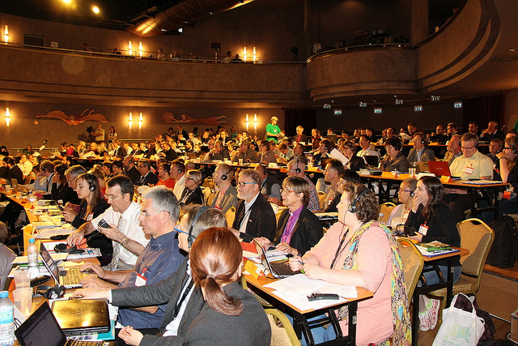

Slide 4
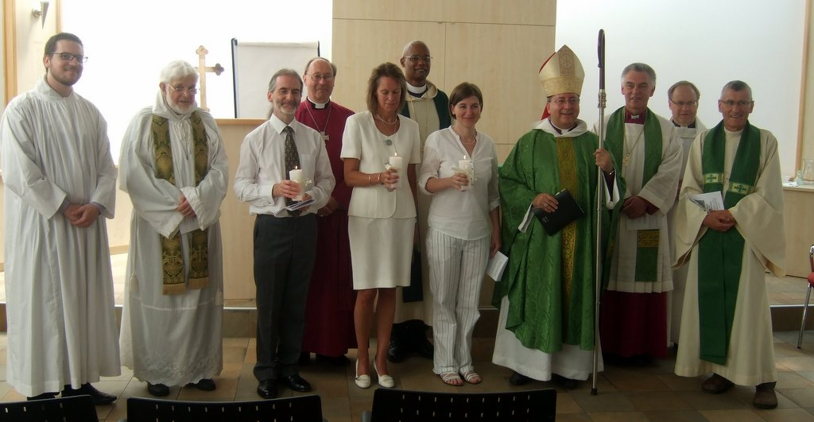

Slide 5
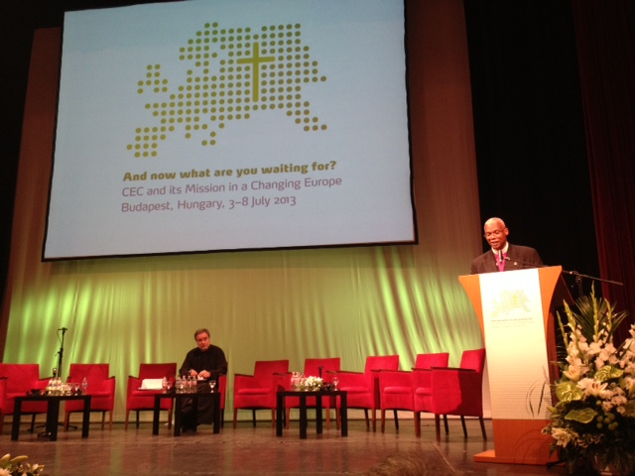

Slide 6
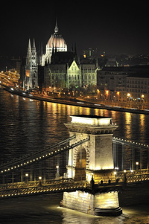
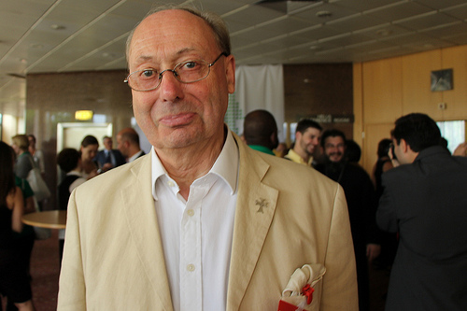

Slide 7
Decisions Assembly
1. We voted a new Constitution
2. We move Geneva office to Brussels
3. We integrate the different commissions
4. We want to improve work with other REO’s in the World
6. We want to better the communication
7. We want a transparent financial structure

Slide 8
Thematic areas
Ecclesiology and theology
Diaspora and migrant churches
Asylum and migration
Youth and intergenerational dialogue
Social responsibility and human rights.

Slide 9
Transition
after Budapest

Slide 10
Goal:
Legal body under Belgian law
Negotiations with CSC
Transition period between old and new
Some actions:
Standing orders CEC ☺ June 2014
Membership fee ☺ December 2014
Organisations in Partnership ☺ June2014
Communications ☺ June 2014

Slide 11
Database ☺ March 2014
Archives ☺ June 2014
Accommodation building ☺ June 2014
One Financial structure ☺ January 2016

Slide 12
Important from CEC perspective - relations with
Church offices in Brussels
Organizations in partnership
CPCE
Roman Catholic Church
WCC
NCC’s
Local Churches
European Evangelical Alliance
Global Christian Forum
Pentecostal European Fellowship
Christian World Communions
International Council of Christians and Jews

Slide 13
Snapshots general activities
Ecumenical conference in 2017 500th anniversary of the Protestant
Reformation
CEC-CCEE May 2014 (Greece): Improving the situation of
Roma people in Europe : patoral challenges and discussions.
CEC/CCEE Joint Committee (Hannover) : Communication of Christian
Faith in Today’s Europe’.
4th Ecumenical Assembly
Consultation Youth Organisations
GlobeTheoLib collaboration

Slide 14
Work continues on globalisation and ecology, human rights, and poverty
and social exclusion through the transition period.
CEC hire a new communication officer in 2014
CEC is starting to organise a conference of the churches on the so-called
social dimension of the Economic and Monetary Union.
EU-Presidency meeting: Athens CEC was in Greece to talk with H.E. Mr.
Dimitris KOURKOULAS, Deputy Minister for European Affairs.
Conference: Youth employment in Europe – a challenge for Churches?
March 2014 - Brussels.
Summer human rights course – Serbia August 2014
Training Freedom of Religion and belief in Germany for 2014 hosted by the
Baptist Union. (An idea for Baptists in Estonia?)

Slide 15
2015 for the Nordic region - summer human rights Stockholm .
2015 training FORB in Türkiye
2013 13 countries in Palermo, Italy for training on social, economic and
cultural rights.
Participation European NGO platform on asylum and migration
Climate Change Conference Warsaw 2013, one day seminar on the role of
ethics, lifestyle, solidarity and global justice in environmental protection and
climate change.
"Collective Complaint" to the European Committee on Social Rights
(ECSR) against the Netherlands.
Situation of Spanish pastors
First EU Forum on labour trafficking – Vilnius 2013.

Slide 16
To read the leaflet select your language:
CZ - DE - EN - FR - GR - HU - IT - P - SK - SP

Slide 18
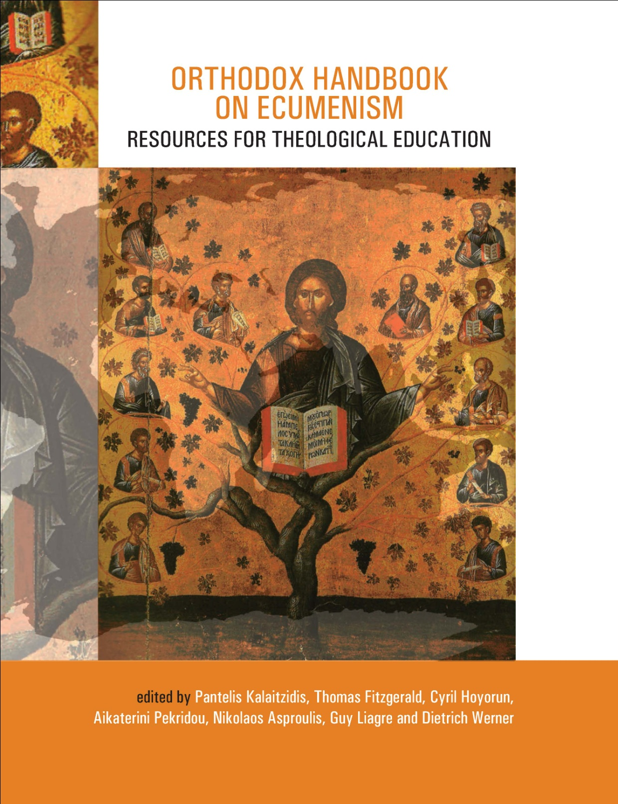

Slide 19
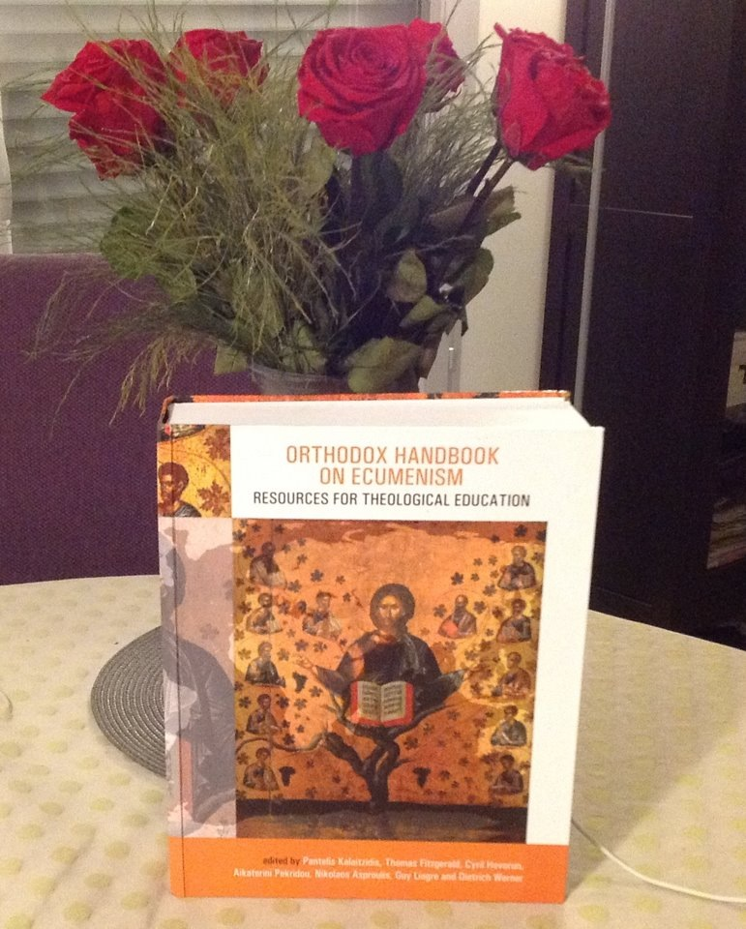
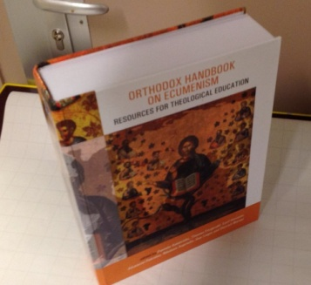

Slide 20
The 4th Consultation of the Theological Faculties in Europe was held from the 25th to the 28th of September 2013 at the
Theological Faculty of Graz.
The focus of the meeting was on identifying and analysing the economic, social and
psychological challenges that impact on human dignity.
It brought together academics from Eastern and Western European institutes of higher studies.

Slide 22
“Vision without action is merely dreaming. Action with no vision is just passing time. But with vision and action you can change the world”
Nelson Mandela

